Slide 1
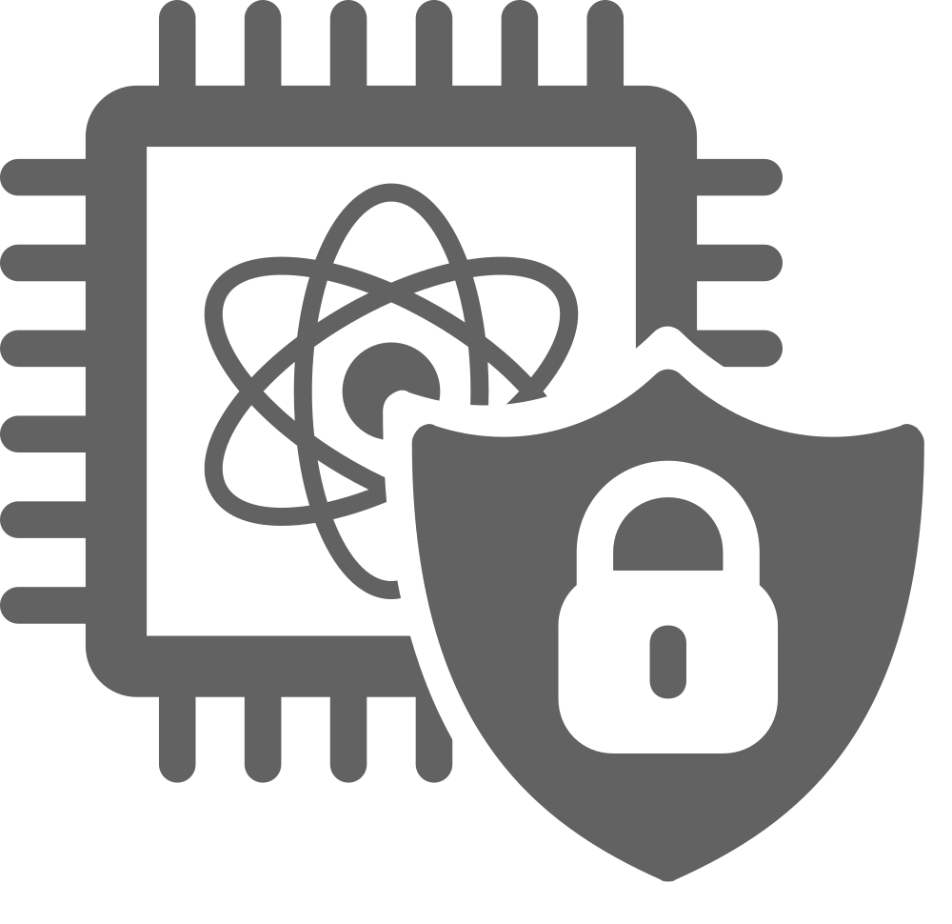
Secure
Quantum Computing
FTQC-1-B-4b: Fault Injection on Error Correction Algorithm
Jeremiah Woods
June 9th, 2026

Slide 2
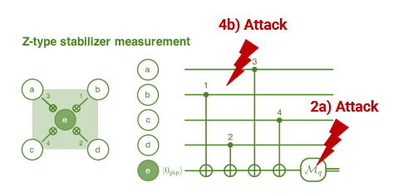
Fault Injection on Error Correction Algorithm
Simulating QEC algorithms’ response to various injected faults
  Using a rotated Z-basis, distance—3 surface code, injecting error directly into the circuit

Slide 3
Threat Model
Assuming attacker has physical access to the qubits
Can insert gates at any position within the circuit
Can see final readout of ancilla qubits and decoder output
Want to induce the most error into error correction algorithm
Wrong suggestion from decoder
Wrong qubits identified as erroneous, et cetera.

Slide 4
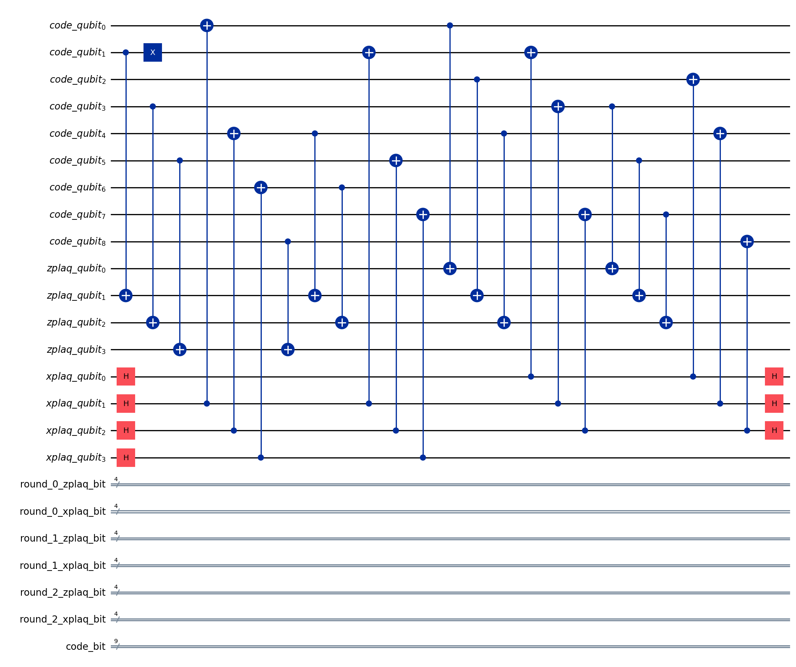
Experimental Setup
3 Jupyter notebooks using Python
  First tests the surface code using all possible bit flips
    Z-basis, encoding a logical 0
  Second has the same circuit tested against different two-qubit Pauli Twirling configurations
    Noise inserted after one, two, or 3 CNOTs
  Third tests the surface code against qubit rotations
    Not natively supported by Stim
      Projected rotation angle as error probability for X, Z,
      and Y error

Slide 5
Evaluation
Brute force through exhaustive search base
  Use Python’s itertools module to produce all possible combinations of qubits
    Represent qubits via index
Rotations and Bit Flips: separate tests for including only data qubits and including all qubits
  In each test, execute circuit with each combination and pass results into MWPM decoder via PyMatching
    Utilized 1000 shots for each rotation test due to probability projection
Pauli Twirling: separate tests into three sets of combinations
  Execute exhaustive search tests for each layer of CNOTs and pass results into MWPM decoder

Slide 6
Results
Bit Flips: circuit eventually failed 100% of the time, but distribution was non-linear
  Adding more bit flips = higher failure rate up to 5 qubits
    Would drop at 6 qubits before rapidly climbing to 100% failure at 8 qubits
    Similar in all-qubit case: peak at 8 qubits, decline from 9-12 qubits, reach 100% at 16 qubits
  Failure rates of different qubits numbers were always complements of each other
    Ex.: failure rate of 4 qubit flips + failure rate of 13 qubit flips ~= total # of combinations
      Excluded all qubits flipping (due to only having 1 combination)
Qubit Rotations: failure rate generally increases with # of qubits & closeness to 180 degrees
  X-rotation: max >99.5% error rate between 168 degrees and 192 degrees
  Z-rotation: no failures of the decoder at any configuration
    Likely due to Z-basis of rotated surface code; encoded logical zero remains zero
  Y-rotation: similar to X-rotation, though distribution was less uniform
    Sharper increase in failure rates at 96 degrees, comparatively lower failure rates at 48 & 72 degrees

Slide 7
Results (continued)
Pauli Twirling: failure rates had some correlation with layer/gate selection at higher fault counts
  1-CNOT: zero failures; somewhat expected due to distance-3 protection against isolated single faults
  2-CNOT & 3-CNOT:
2-CNOT |  | 3-CNOT
Layer # | Results [(0, 1), (0, 2), (1, 2)] | Layer # | Results
1 | None; 4/15; None | 1 | 4/15
2 | None; 9/15; 8/15 | 2 | 8/15
3 | 4/15; None; None | 3 | None
4 | None; 8/15; 4/15 | 4 | 8/15
5 | None; None; 4/15 | 5 | None
6 | 4/15; 8/15; None | 6 | 7/15
7 | None; 4/15; None | 7 | 4/15
8 | 8/15; 8/15; None | 8 | 8/15

Slide 8
Summary
Distance-3 rotated surface code has limited protection against multiple faults
Correlated faults, such as targeting multiple CNOT gates at once, tended to be more successful in disrupting decoder
Utilizing rotations instead of direct error flips does not appear to be significantly more disruptive
More work, such as incorporating native rotation gates & testing different bases/encoded states, is needed to confirm these results

